Slide 1
Code Optimization
with GPT-3
OpenAI Climate Challenge

Slide 2
Overview
Code4Climate
Project Thesis
Risks
Results
Next Steps
Table of contents
Computing Power & Environmental Impact
Use-cases & reduction
Optimizing code to reduce emissions
Potential issues with code optimization
Model performance on small training sets
Further applications of code optimization

Slide 3
Overview
1
Current CO₂ emissions and requirements at a collective level

Slide 4
What’s happening:
418 ppm
38.9 Gt
1.2 ℃
CO₂ in the atmosphere now
CO₂ emitted in 2021
global average temperature anomaly in 2021

Slide 5
What needs to happen:
507 ppm
17.9 Gt
1.5 ℃
CO₂ in the atmosphere in 2030
CO₂ emitted in 2030*
global average temperature anomaly in 2030
*Assuming emissions in 2015 were 35.7 GtCO₂

Slide 6
Climate and Code
2
Effects of computing and code optimization on CO₂ emissions

Slide 7
40% of CO2 emissions
from energy production
belong to electricity

Slide 8

Coding is used everywhere.

Slide 9
Coding activities CO₂ emissions
~340 Mt
~70 Mt
Cloud
Blockchain
CO₂ emitted by data centres & networks*
CO2 emitted by crypto currency mining*
*Assuming an emissions factor of 0.5 kgCO₂ / kWh ** Estimate based on individual consumption of household PC, laptops and mobile devices

Slide 10
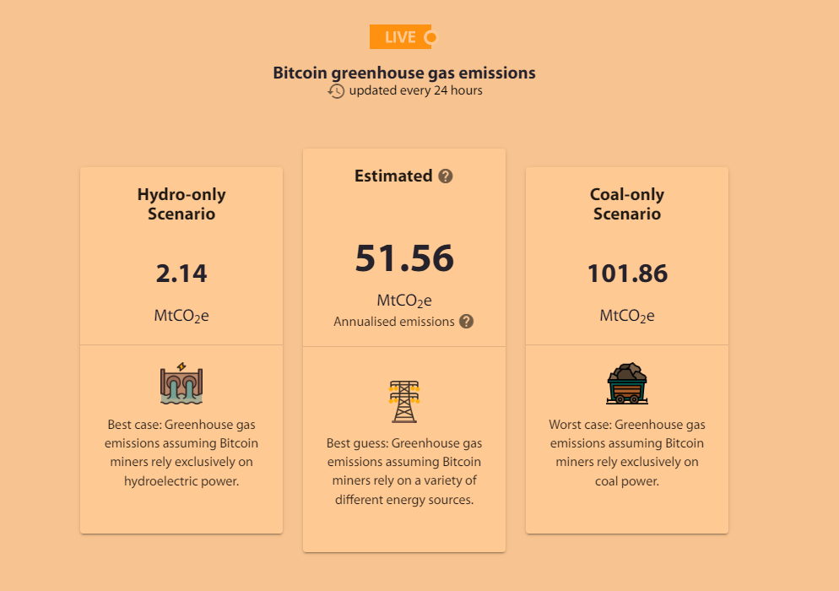
Bitcoin releases ~51 MtCO₂
per year
This assumes that the energy sources behind Bitcoin’s blockchain are diversified, although in a coal-only scenario those would be 2x the amount.

Slide 11
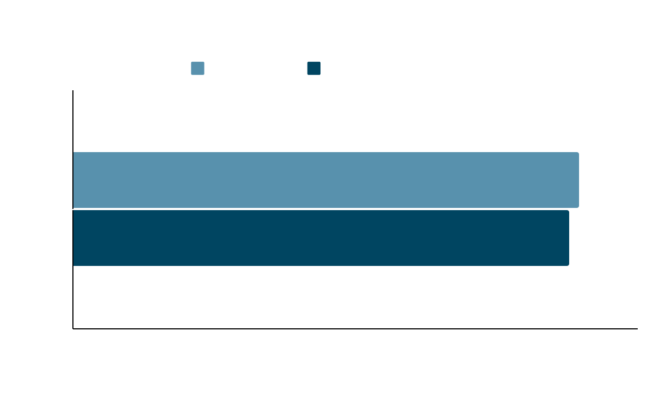
Case Study:
2%
7 Mt
Improving Google’s Search Algorithm
change in efficiency
=
CO₂ saved every year

Slide 12
Project Thesis
3
Developing a GPT-3 based code optimizer to decrease scope 1 carbon emissions

Slide 13

ClimateCode.io
The app that allows you to write efficiency optimized code

Slide 14
Development Process
Code
Fine-Tune
Deploy
We collected coding examples from Kaggle^{[1]}, HackerRank, and personal repositories.
We fine-tuned GPT-3 on the labelled dataset.
We created a web app for users to improve their code.
Ask GPT-3
Ask GPT-3
We asked GPT-3 about the coding complexity^{[2]} of our code to label our training set.
We asked GPT-3 to recommend optimized code for an unseen dataset.
Training
Testing

Slide 15
ClimateCode.io
Click on the tablet to be redirected to the web app.

Slide 16
Risks
4
What are potential issues that can arise and how do we tackle them

Slide 17

Introducing errors
Production-level code can have thousands of lines and optimizing for one function might introduce errors in another

Slide 18
Introducing errors
Introduce testing and warnings
Production-level code can have thousands of lines and optimizing for one function might introduce errors in another

Slide 19
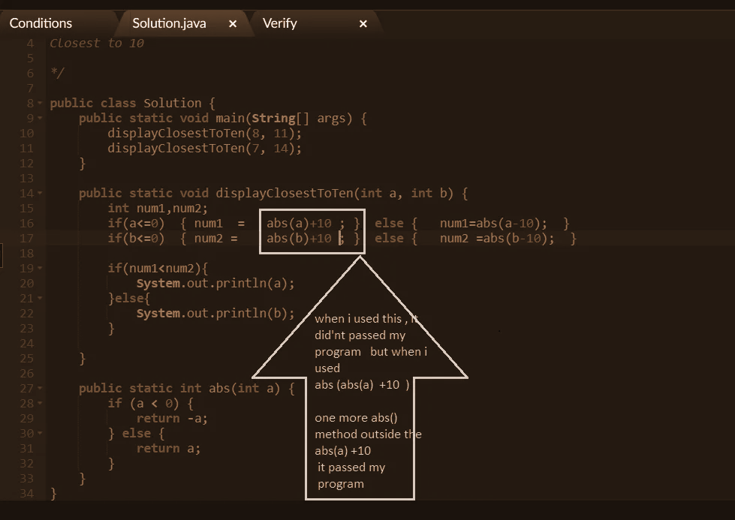
Invalid
Code
Even if GPT-3 was trained to recognize and produce code it might be invalid

Slide 20
Invalid
Code
Introduce code validation
Even if GPT-3 was trained to recognize and produce code it might be invalid

Slide 21
Next Steps
5
How to improve current results and broaden the application of the model

Slide 22
Improvements on current model
Get larger corpora of labelled data
Using more code examples would improve the performance of GPT-3 on more diverse coding tasks
Adapt the model to multiple programming languages
The current model is primarily trained on C++ code but it would prove far more useful if it integrated more popular languages
Integrate the model with educational resources
Although code optimization is a great resource for reducing climate emissions, it can also be a valuable tool in teaching next generation of programmers to write more environmentally-friendly code

Slide 23




Thank you from GlobeGeeks 🌍
Carl W.
Luc M.
Sabina F.
Serjan K.
Master student - AI in robotics and autonomous systems. Hobbies: running, cycling, reading
PhD student - Reinforcement Learning for robotics control. Hobbies: guitar, watercolour art, Go
Data Analyst - ESG and corporate emissions. Hobbies: tango, finance, natural languages
Student - NLP & BCI research. Hobbies: writing, dancing, reading

